Slide 2
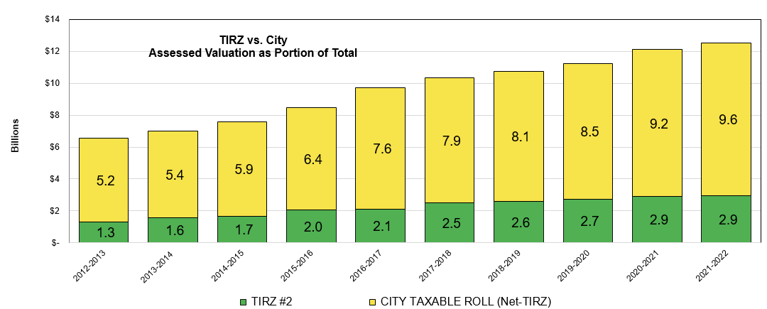
Taxable Value
Revaluations and growth in our high-quality community have increased the taxable roll (excluding the Shadow Creek TIRZ) to $9.6B, an 4.3% increase from the year prior.
The FY 22 budget is based upon values received from Brazoria County (includes Harris and Fort Bent Counties) on 8/2.
Thank you to Brazoria County for their assistance as we continue to adapt to SB2’s changes to tax laws.

Slide 3
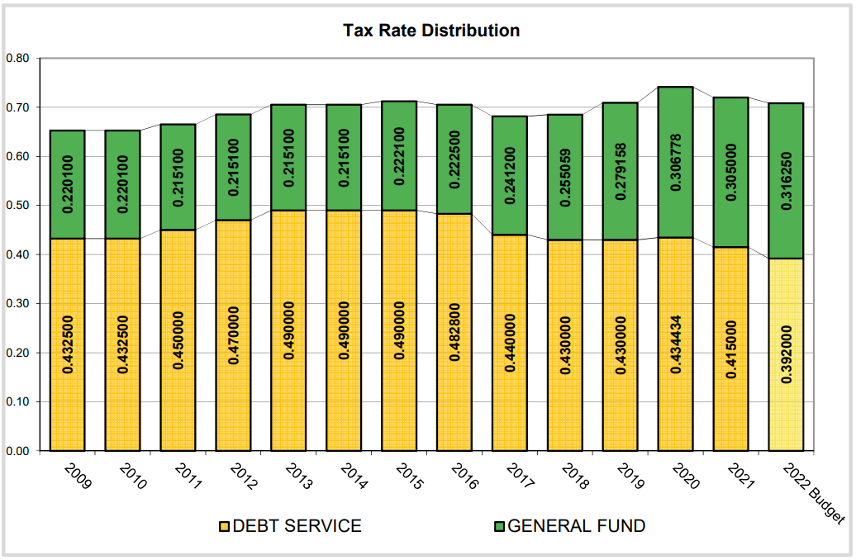
Property Tax Revenue
A 1.175 cent decrease in total rate from FY21.
This is the second year in a row Pearland has proposed a budget below the no-new-revenue rate (a property tax revenue cut according to State’s required worksheet).
$27M in current collection to the General Fund; $34M to Debt Service Fund.
As recently as FY13 and FY 14 the debt rate was 71% of the levy, leaving only 30.5% available for operations. Debt rate includes the subsidy incentive for in-City MUD rebates which has grown by $475,544 since FY21 to a total of $7.7M.
FY 22 makes 45% available for operations, which is a 2.7% increase from FY21.

Slide 4
Property Tax Decreases Since FY20
Year | No-New-Revenue Tax Rate | City Adopted / Proposed Rate | Difference between No-New-Revenue Rate and City Rate
FY21 | 0.737640 | 0.720000 (adopted) | 0.017640
FY22 | 0.735485 | 0.708250 (proposed) | 0.027235
 |  | Difference | 0.044875

Slide 5
Proposed Property Tax Rate for FY22
0.316250 + 0.392000 = 0.708250
Maintenance & Operations Rate
Debt Rate
Total Proposed Property Tax Rate

Slide 6
Council Discussion: Lowering the Property Tax Rate and Revenue
A property further tax rate cut is not recommended by staff as a cautious move to provide flexibility and meet future needs and commitments
If Council wishes to further lower the property tax rate the following amendment must be made:
“proposing an amendment to reduce the property tax rate from a total of 0.708250 to 0.701416 – a difference of 0.006834 to be removed from the O&M portion of the rate.”
This will reduce property tax revenue by $678,266 and TIRZ Administration revenue by $73,370 – a total of $751,636.
The total effect on the General Fund will be a reduction in revenue from a total of $100,353,728 to $99,602,092” – a reduction of $751,636.

Slide 7
FY22 Property Tax Rate (City portion)
Questions on tax rate?
Next Step: Vote on proposed tax rate (Second & Final Reading)

